Slide 1
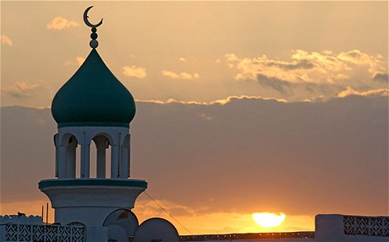
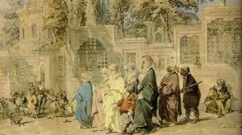
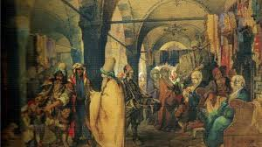
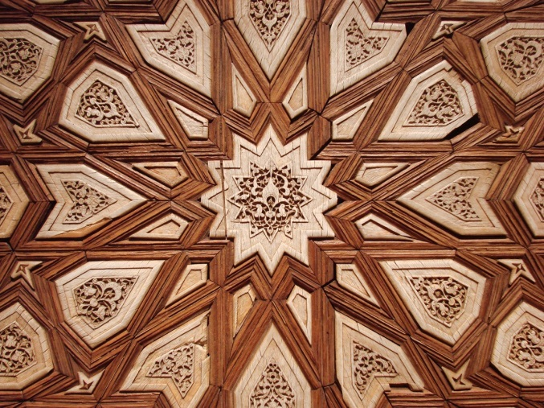
The Rise of Islam

Slide 2
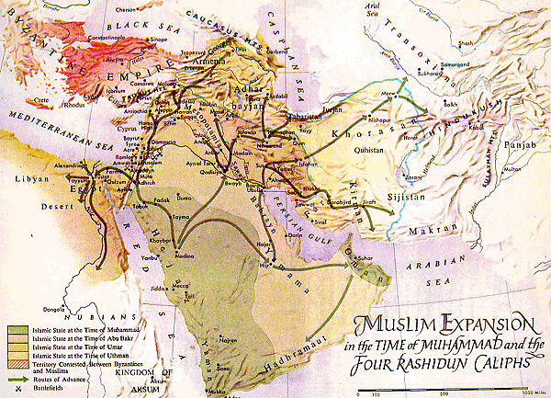
Where Islam Started
Arabian peninsula
Crossroads of 3 continents
Africa, Asia, Europe
Location where many trade routes would meet

Slide 3
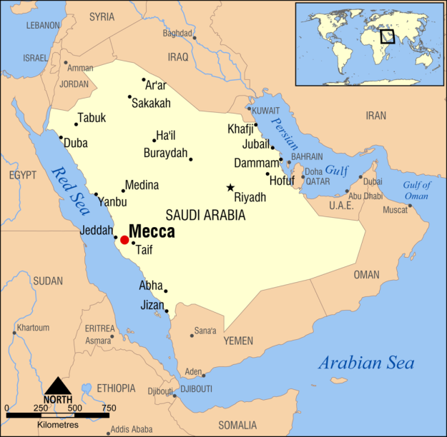
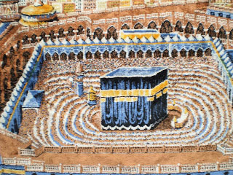
Where Islam Started
City of Mecca
Many Arabs came to worship at an ancient shrine.
Called the Ka’aba
Polytheism before the start of Islam
Many Christians and Jews also practiced their religion on the Arabian Peninsula.
Monotheism

Slide 4
Muhammad
Born into a powerful Meccan family
Became a trader/merchant
Took great interest in religion
Spent much time in prayer and meditation

Slide 5
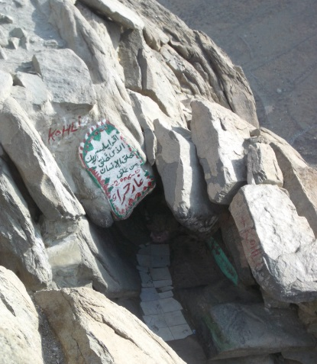
Islam Begins
Muhammad believed he was called by the angel, Gabriel, during meditation in a cave outside Mecca.
Told him he was a messenger of Allah
He believed he was the last of the prophets.
Began to teach that Allah was the one and only God.
All other gods must be abandoned.

Slide 6
Islam Begins
People who agreed to the basic principles of Islam were called Muslims.
Islam means “submission to the will of Allah.”
Muslim means “one who has submitted.”

Slide 7
Beginning Struggle
Many people in Mecca were hostile towards this new belief.
After attacks on Muhammad and his followers, they migrated south to the town of Yathrib.
Later would be renamed Medina.
Migration was known as the Hijrah.
Gained many more followers in Medina.
Also became a strong religious and military leader there.

Slide 8
Return to Mecca
Marched to Mecca with many followers.
The city surrendered to Muhammad.
He destroyed the polytheistic idols at the Ka’aba.
Held a call to prayer from its roof.
Islam gained many more followers.

Slide 9
Beliefs and Practices
FIVE PILLARS
Must testify that “There is no God but Allah, and Muhammad is the Messenger of Allah.”
Pray 5 times a day facing towards Mecca.
Alms (Money) giving: Supporting the less fortunate.
Fasting: During the holy month of Ramadan, no eating between dawn and sunset. Reminds them that their spiritual needs are greater than their physical needs.
Pilgrimage to Mecca at least once in a Muslim’s life.
Known as the hajj

Slide 10
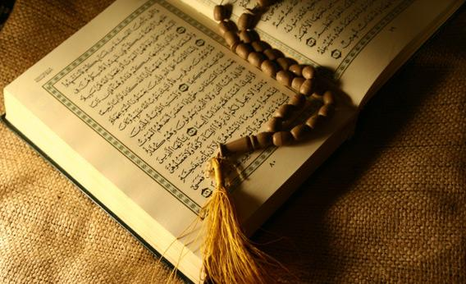
Beliefs and Practices of Islam
Qur’an: Holy book of the Muslims.
Sunna: Muhammad’s example as the best example for proper living.
Shari’a: System of law regulating family relationships; moral conduct; and business, political, and community life.

Slide 11
Islam Expands
After Muhammad’s death:
Muslim community used ancient tribal custom to elect a successor.
Abu-Bakr chosen
First caliph
Successor or deputy.

Slide 12
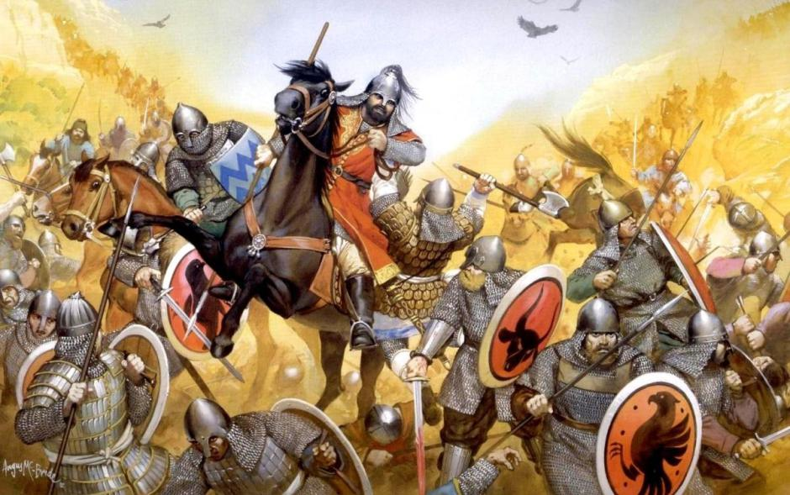
Islam Expands
Conquered lands controlled by the Byzantine Empire, which had grown weak.
Many welcomed the Muslim armies
They had suffered under Byzantine rule.
Allowed conquered peoples to keep their own religion, but could not spread it.

Slide 13
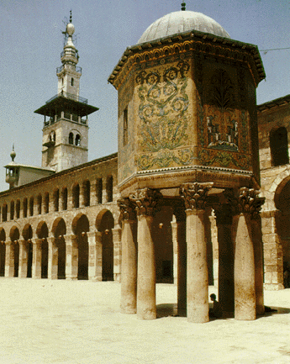
Internal Conflict
Civil war, assassinations, and struggle followed.
Umayyads (a powerful family) came to power.
Moved Muslim capital to Damascus.
Caliphs started to act like kings and kept enormous wealth.
Caused a division in Muslim community

Slide 14
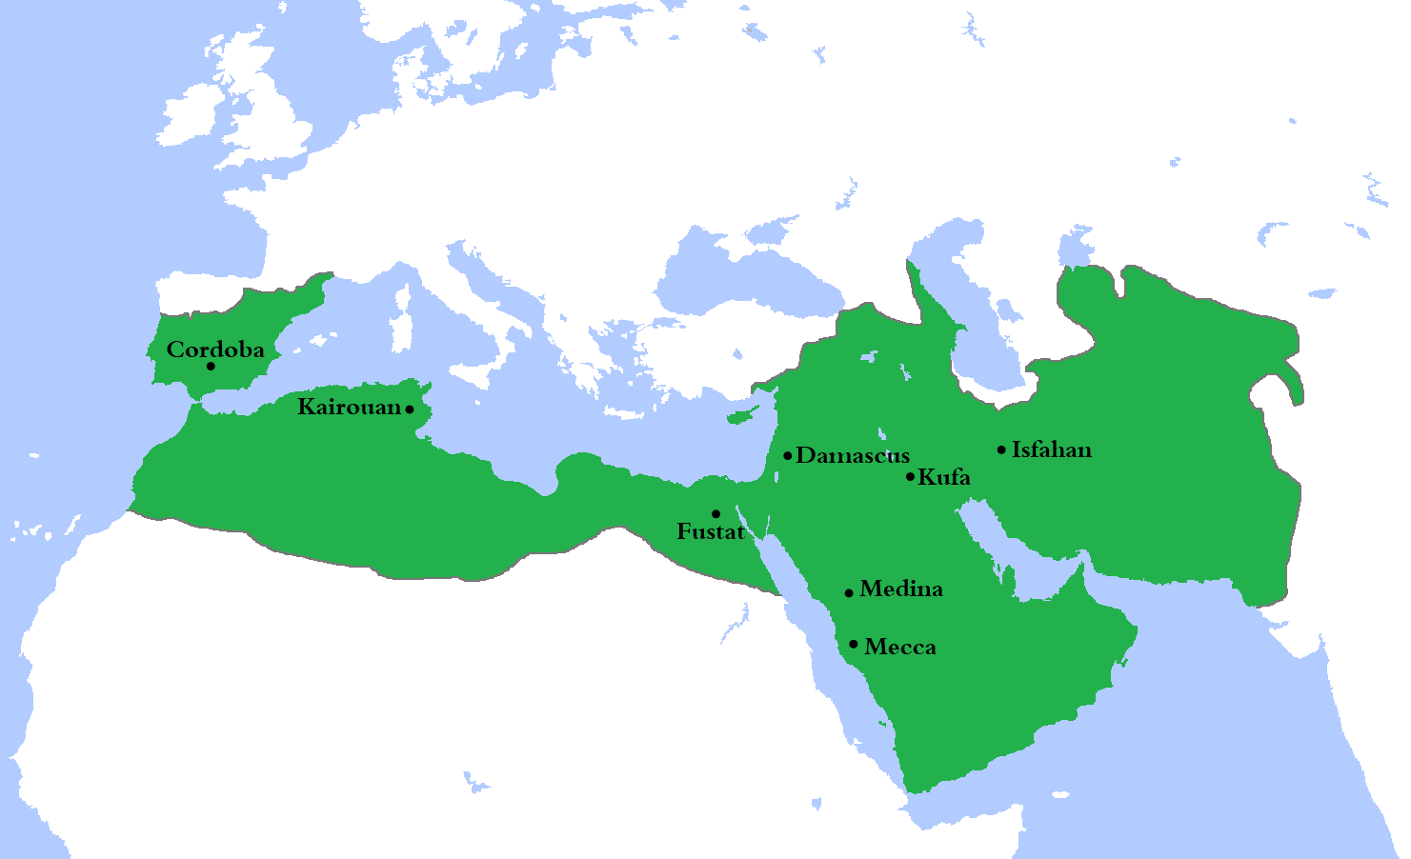
Umayyad Empire

Slide 15
Internal Conflict
Sunni-Shi’a split in Islam
Shi’a: Believed the caliph needed to be a descendant of Muhammad.
Sunni: Followers of Muhammad’s example.
Sufi: Rejected the luxurious life of the Umayyads.
Pursued life of poverty and spiritual path.

Slide 16
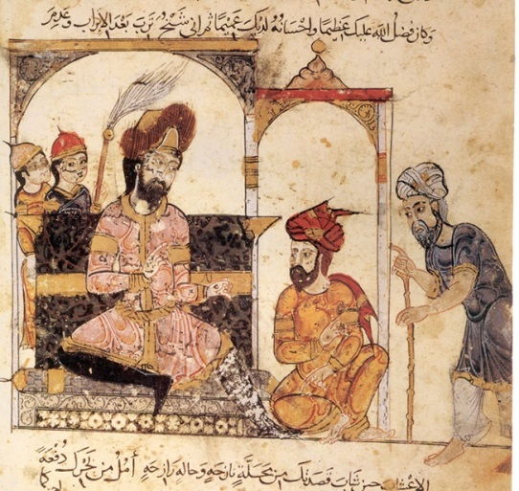
Control Extends
Abbasids
Murdered most of remaining Umayyads.
Moved capital to Baghdad
Located along trade routes
Gave access to goods, gold, and information
Kept strong control
Portions of 3 continents (Africa, Asia, Europe)
TAXES
Territory was too big to control
Rival caliphates rose up

Slide 17
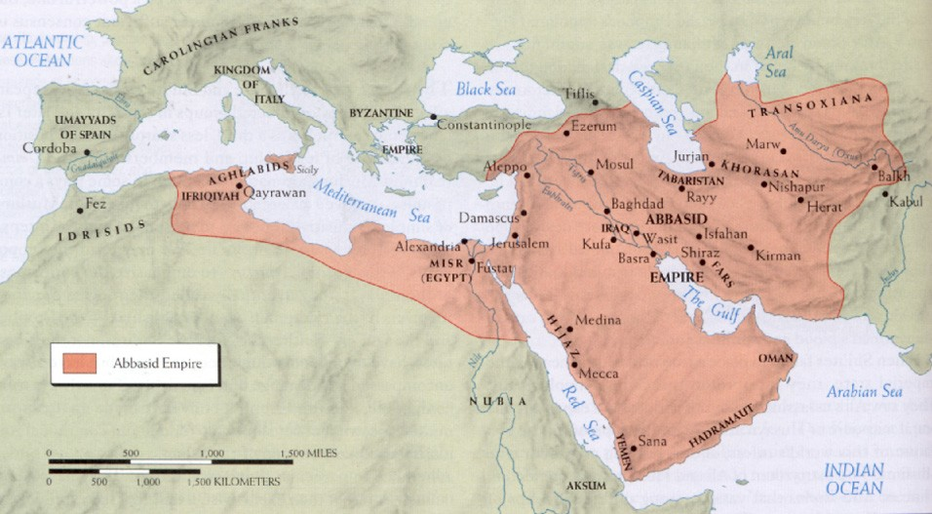
Abbasid Empire

Slide 18
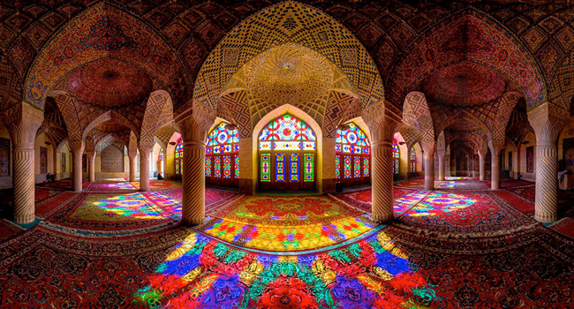
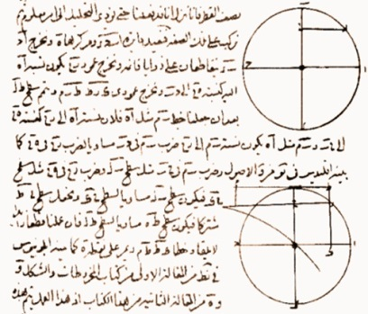
Influence
Literature
Writing was very important
Art/Architecture
Calligraphy
Arches in buildings
Medicine
Studied diseases and treatments
Math/Science
Scientific observation and experimentation
Algebra
Astronomy

Slide 19
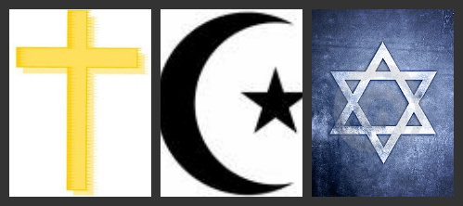
Links to Judaism and Christianity
Allah is seen as the same God worshipped in Christianity and Judaism.
Jesus is mentioned in all three.
Islam sees Jesus as a prophet, and not the Son of God.
All 3 have a holy book.
Judaism: Torah
Christianity: Holy Bible
All 3 trace ancestry to Abraham

